Slide 1
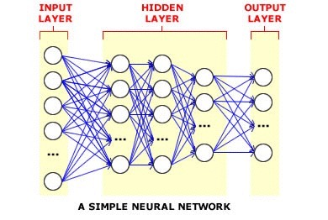
Deep Learning
Deep neural network is a feed-forward artificial neural network with multiple hidden units between input and output
Why Use Deep Neural Networks?
Ability to learn complicated feature representations and classifiers jointly
Learn much better models of data that lie on or near a non-linear manifold
Performance does not saturate with increase in training data
Surpass the performance of the other dominant paradigms

Slide 2
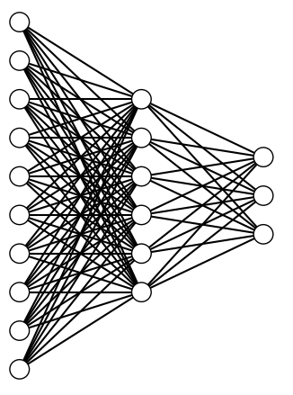
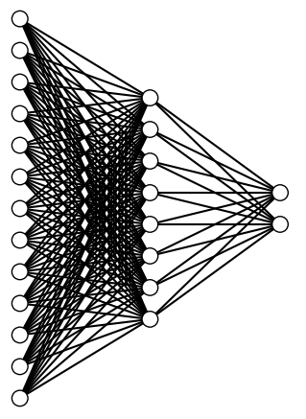
Neural Network Architecture
Representative Architecture
Representative Architecture
Common Parameters
Activation Function:
Hidden Layer : ReLU
Output Layer : Softmax
Regularizer : L1L2
Optimizer : Adadelta
Metric : Accuracy
Output Layer
Output Layer
Hidden Layer
Hidden Layer
Input Layer
Input Layer
Initial Neural Network
Binary Neural Network(s)
Input Dimension : 180
Hidden Layer : 12
Output Layer : 3
Loss Function : Categorical Crossentropy
Input Dimension : 380
Hidden Layer : 22
Output Layer : 2
Loss Function : Binary Crossentropy

Slide 3
Hybrid Neural Network Model
Both Initial and Binary were using Keras Library which is a high-level neural networks library, written in Python, capable of running on top of either Tensor Flow or Theano and enables fast experimentation. It allows easy specification of the characteristics of the network.
The Initial NN is trained with audio speech samples for all languages and produces the top 2 most probable language candidates.
Binary NN(s) are trained with audio speech samples for all language pairs.
Final output is produced by using the top 2 candidates and inputting them to the appropriate Binary Classifier.

Slide 4
Prediction Visualization through GUI
GUI was made to illustrate the functioning of the Hybrid Neural Network Model.
PyQt5 was used to design the GUI.
Allows the user to select any .mp3 file.
Provides frame wise language prediction for the audio sample.
Provides final language prediction for the audio sample.

Slide 5
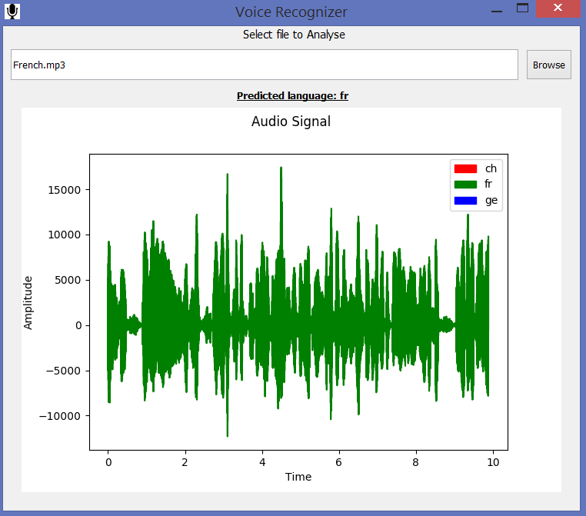
GUI Sample

